Slide 1
Using figma create a responsive landing page
CAPSTONE PROJECT
Presented By:
NITHINA RAJ R
3rd year Artificial Intelligence and Data Science
Dhanalakshmi Srinivasan College of Engineering, Coimbatore

Slide 2
OUTLINE
Problem Statement
Proposed System/Solution
System Development Approach
Algorithm & Deployment
Result
Conclusion
Future Scope
References

Slide 3
Problem Statement
The current online book marketplace lacks an intuitive and engaging platform for users to discover, purchase, and review books. Many existing sites suffer from poor navigation, limited search functionality, and insufficient personalized recommendations, leading to user frustration and reduced sales. Additionally, authors and publishers have limited visibility and promotional tools to reach their target audiences.
User Experience: Create a user-friendly interface that allows for easy navigation and access to a vast catalog of books.
Search Functionality: Implement advanced search features, including filters by genre, author, rating, and price, to enhance discoverability.
Personalized Recommendations: Develop an algorithm that provides tailored book suggestions based on user preferences and past purchases.
Community Engagement: Incorporate features for user reviews, ratings, and book clubs to foster a sense of community among readers.
Author and Publisher Tools: Provide resources for authors and publishers to promote their works effectively through ads, featured listings, and promotional events.

Slide 4
Proposed Solution
1. User-Friendly Interface: - Design a clean, intuitive layout with easy navigation menus, ensuring users can effortlessly browse and find books.
2. Advanced Search and Filtering: - Integrate a powerful search engine that allows users to search by title, author, ISBN, and keywords.
3. Personalized Recommendation Engine: - Develop a recommendation algorithm using machine learning to analyze user behavior and preferences, suggesting books based on past purchases and ratings.
4. Community Features: - Create a robust review and rating system where users can share their thoughts on books.
5. Promotional Tools for Authors and Publishers: - Offer marketing tools such as featured listings, promotional banners, and targeted advertising options for authors and publishers.
6. Secure Payment and User Accounts: - Implement a secure and streamlined payment system that supports multiple payment methods.
7. Analytics and Feedback Loop: - Utilize analytics tools to monitor user behavior, sales trends, and website performance, informing continuous improvements.

Slide 5
System Approach
1..Agile Methodology: Utilize Agile principles to allow for flexibility and iterative development. This will enable rapid adjustments based on user feedback and changing requirements.
2. Project Phases: Planning, Design, Development, Testing, Deployment, Maintenance and Updates.
3. Frontend: HTML, CSS, JavaScript frameworks (e.g., React or Vue.js) for an interactive user experience. Backend: Node.js or Python (Django/Flask) for robust server-side functionality.
Database: Use a relational database (e.g., PostgreSQL) or NoSQL (e.g., MongoDB) for flexible data storage. - Hosting: Cloud services (e.g., AWS, Azure) for scalability and reliability.
4. Collaboration Tools: - Utilize project management tools (e.g., Jira, Trello) to track progress and tasks. Use communication platforms (e.g., Slack, Microsoft Teams) for team collaboration and updates.
5. User Feedback Loop: - Implement feedback mechanisms post-launch (e.g., surveys, analytics) to continually refine features and user experience.

Slide 6
TECHNIQUES & Deployment
1. Environment Setup: - Development Environment: Set up local environments for developers using Docker or virtual machines to ensure consistency. - Staging Environment: Create a staging environment that mirrors the production environment for final testing.
2. Cloud Deployment: - Cloud Service Provider: Choose a cloud provider (e.g., AWS, Google Cloud, Azure) for hosting. - Containerization: Use Docker containers to package applications, making deployment consistent across environments.
3. Continuous Integration/Continuous Deployment (CI/CD): - Set up a CI/CD pipeline using tools like Jenkins, GitHub Actions, or GitLab CI to automate testing and deployment. - Ensure that every code change triggers automated tests and, upon passing, deploys to the staging environment.
4. Load Balancing and Scalability: - Use load balancers to distribute incoming traffic across multiple servers to enhance performance and reliability. - Implement auto-scaling to dynamically adjust resources based on user demand.
5. Monitoring and Analytics: - Integrate monitoring tools (e.g., New Relic, Grafana) to track application performance, user behavior, and server health. - Set up analytics (e.g., Google Analytics, Mixpanel) to gather insights on user interactions and engagements.

Slide 7
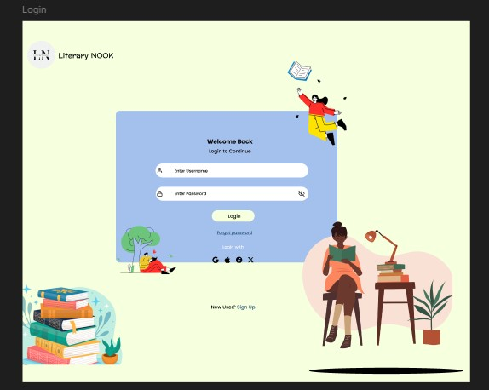
Result

Slide 8
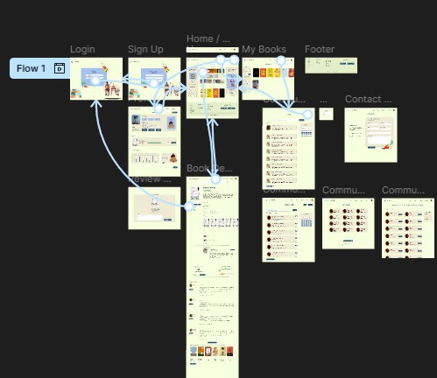
Result

Slide 9
Conclusion
The proposed book website aims to create an engaging and user-friendly platform that addresses the current gaps in the online book marketplace. By focusing on enhanced user experience, personalized recommendations, community engagement, and robust features for authors and publishers, the website is poised to foster a vibrant literary ecosystem. With a clear development approach, including the use of agile methodologies, advanced algorithms for personalized content, and a comprehensive deployment strategy, the project can adapt to user needs and technological advancements. Furthermore, the outlined future scope presents opportunities for growth and innovation, ensuring that the platform evolves alongside its users. In conclusion, this book website not only seeks to improve book discovery and purchasing but also aims to build a community of readers, enhance author visibility, and promote a love for literature. By embracing technology and user feedback, the website can achieve its goals and establish itself as a leading destination for book enthusiasts.

Slide 10
Future scope
1. Enhanced Personalization: - AI-Powered Recommendations:In tegrate advanced machine learning models to refine recommendation algorithms based on user interactions and feedback. - User Profiles: Develop more detailed user profiles to provide tailored content, including personalized newsletters and reading challenges.
2. Community Building: - Social Features: Introduce features such as friend connections, direct messaging, and shared reading lists to foster community interactions. - Events and Webinars: Host virtual book fairs, author Q&As, and themed reading events to engage users and promote new releases.
3. Multi-Media Content: - Audiobooks and E-books: Expand the catalog to include audiobooks and e-books, providing users with more format options. - Content Integration: Allow authors to publish articles, interviews, and essays related to their works to enrich user engagement.
4. International Expansion: - Localization: Adapt the platform for international markets by offering multilingual support and region-specific recommendations. - Global Partnerships: Collaborate with international publishers and authors to diversify the book selection.

Slide 11
References
https://www.figma.com/proto/kmE7t2ljnEW06gCx8aZRKV

Slide 12
THANK YOU

